Slide 1
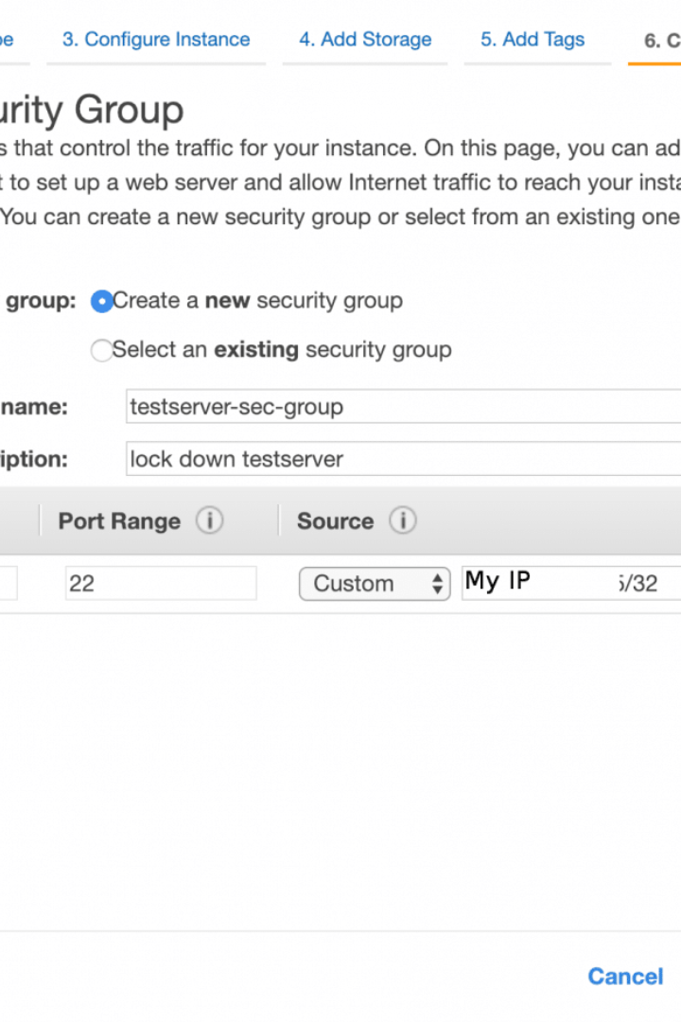


Understanding Linux Security Permissions
Learn how to control access to files and directories in Linux with a permission system.
by Shravani Potharaju

Slide 2

Introduction to Linux Security Permissions
Linux uses a permission system to control access to files and directories. The three key categories are User (u), Group (g), and Others (o).

Slide 3
Permission Categories
User (u)
Group (g)
Others (o)
Permissions for the file's owner.
Permissions for users in the file's group.
Permissions for everyone else.

Slide 4

Symbolic Notation
Use **r** (read), **w** (write), **x** (execute), **-** (no permission) to denote file permissions. For example, **rwxr-xr--** means that the user has read, write, and execute permissions; the group has read and execute permissions; and others have read-only permission.

Slide 5

Octal Notation
Use three-digit numbers (0-7) to denote file permissions in octal notation. For example, **764** means the owner has read (4) + write (2) + execute (1) permissions; the group has read (4) + write (2) permissions; and others have read (4) permissions.

Slide 6

Changing Permissions
Use the **chmod [options] permissions file/directory** syntax to change file permissions. For example, **chmod 755 myfile** grants full access to the owner and read/execute access to the group and others.

Slide 7

Adding Permissions
Use the **chmod +[permissions] file/directory** syntax to add file permissions. For example, **chmod +x myfile** adds execute permission to "myfile."

Slide 8

Deleting Permissions
Use the **chmod -[permissions] file/directory** syntax to delete file permissions. For example, **chmod -w myfile** removes write permission from "myfile."

Slide 9

Viewing Permissions
Use the **ls -l** syntax to display detailed file information, including permissions. For example, **ls -l myfile** displays the file's permissions.

Slide 10

Changing Ownership
Use the **chown [options] newowner:newgroup file/directory** syntax to change file ownership. For example, **chown user1:group1 myfile** changes ownership to "user1" and "group1" for "myfile."

Slide 11

Conclusion
To ensure security, it's crucial to understand how to properly set file and directory permissions in Linux. Proper permissions are key to keeping your files and system secure.

Slide 12

Thank You
Thank you for attending this presentation on Linux security permissions. For further inquiries, please contact us at [email protected].

